Slide 1

A Project Stage I Presentation on
“Title of the Project”
Under the Guidance of
Name of your Guide
Presented by
Name of Student 1 (Seat No) Name of Student 2 (Seat No) Name of Student 3 (Seat No) Name of Student 4 (Seat No)
Department of Artificial Intelligence & Data Science
Matoshri College of Engineering & Research Centre, Nashik 2024-2025

Slide 2

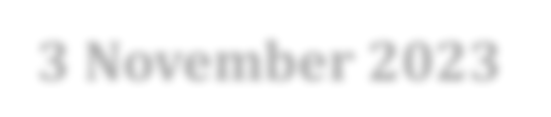


Presentation Outline
Introduction (Overview, Need, Problem statement, Objectives)
Literature Survey
Proposed System Architecture
Details of Modules
Algorithm
Design (DFD, UML Diagrams)
Software Hardware Requirements
Conclusion
References

Slide 3

Introduction
Overview
AI DeepGuard Detection is a web-based system for detecting potentially manipulated facial images.
It uses image processing and a deep-learning model to classify images as Real or Fake.
It displays prediction confidence and visual explanations using Grad-CAM/heatmaps.
The system is designed using Flask, Python, HTML, CSS and JavaScript.
Need
AI-generated and manipulated images can spread misleading information.
Manual verification of images is time-consuming.
Users need an accessible way to analyze suspicious facial images.
Visual explanations can help users understand model predictions.

Slide 4
Introduction
Problem Statement
To develop a web-based AI system that identifies potentially manipulated facial images and presents classification results, confidence scores and visual explanations through a user-friendly interface.
Objectives
Develop a web-based deepfake image detection system.
Accept and validate image uploads.
Detect and preprocess facial regions.
Classify images as Real or Fake using a trained model.
Display prediction confidence and analysis results.
Generate Grad-CAM heatmaps to visualize relevant image regions.
Maintain detection history and generate downloadable reports.
Provide user authentication and an administrator dashboard.

Slide 5
Literature Survey
Research paper | Main contribution | Relevance to our project
LAA-Net, CVPR 2024 | Uses localized artifact attention for generalizable deepfake detection. | Supports analysis of suspicious facial regions.
SIDA, CVPR 2025 | Combines image deepfake detection, localization and explanation. | Closely related to explainable image analysis.
Hybrid Bag-of-Visual-Words and Multi-CNN, 2026 | Combines handcrafted visual features and CNN features for deepfake face detection. | Relevant to feature extraction and classification.

Slide 6
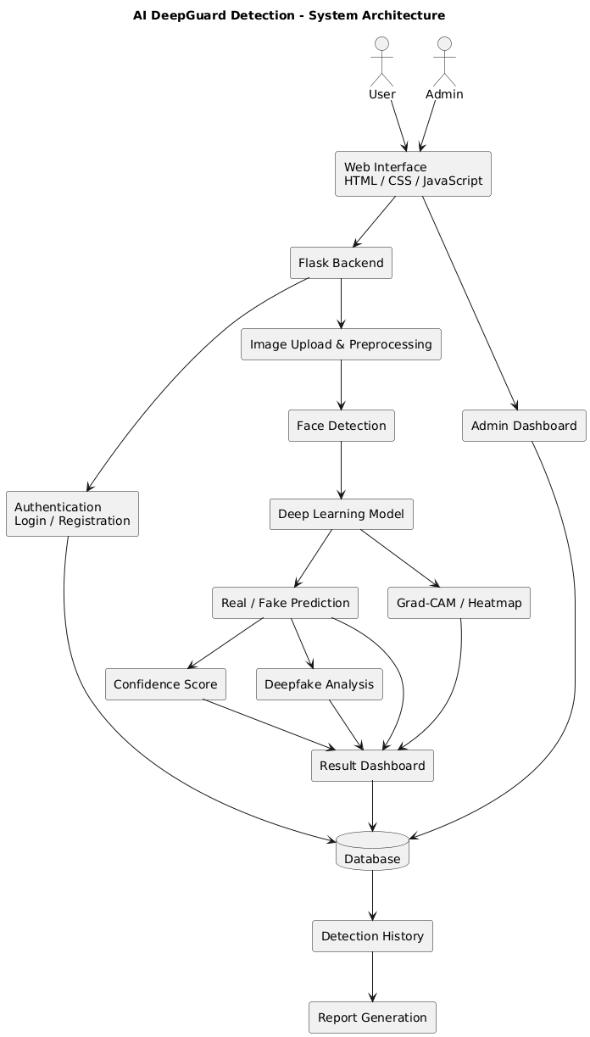
Proposed System Architecture
Paste here whatever u want to explain

Slide 7
Details of Modules
User Authentication: Registration, login and session management.
Image Upload: Accept images and validate file formats and size.
Image Preprocessing: Resize, normalize and prepare images for inference.
Face Detection: Locate and crop relevant facial regions.
Deepfake Detection: Predict Real or Fake using the trained model.
Confidence and Analysis: Display model confidence and prediction details.
Explainable AI: Generate Grad-CAM/heatmap visualizations.
Result Dashboard: Present the uploaded image, prediction and analysis.
Detection History: Store and retrieve previous detections.
Report Generation: Generate downloadable detection reports.
Database Management: Store user and detection records.
Admin Dashboard: Manage users and view system statistics.

Slide 8
Algorithm
Start the application.
Authenticate the user.
Upload and validate the input image.
Preprocess the image into the format expected by the trained model.
Detect and extract the face if required by the model.
Pass the processed image to the deep-learning model.
Obtain the model's output scores or probabilities.
Apply the configured decision threshold to classify the image as Real or Fake.
Generate a confidence score and Grad-CAM heatmap, if supported by the model.
Display the prediction and analysis on the dashboard.
Store the result in the database and generate a report if requested.
Stop.
Algorithm Flow: Input Image → Preprocessing → Model Inference → Classification → Confidence Score → Heatmap → Result.

Slide 9
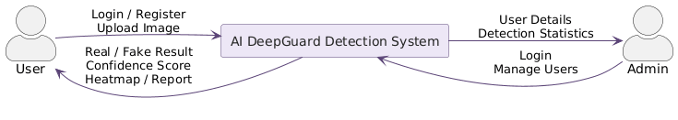
DFD and UML Diagrams
DFD LEVEL 0

Slide 10
DFD and UML Diagrams
DFD LEVEL 1

Slide 11
DFD and UML Diagrams
DFD LEVEL 2

Slide 12
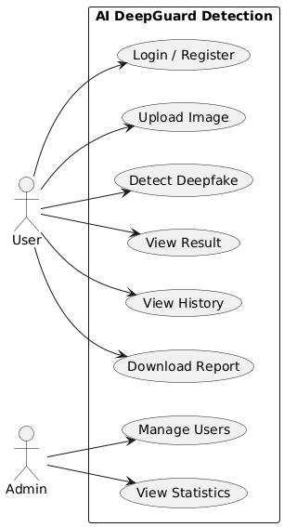
DFD and UML Diagrams
Use Case

Slide 13
Software and Hardware Requirements
Software | Purpose
Python | Backend and AI processing
Flask | Web application framework
HTML, CSS, JavaScript | Frontend interface
PyTorch or TensorFlow | Deep-learning model, depending on implementation
OpenCV | Image processing and face detection
Grad-CAM library / implementation | Model visualization
SQLite or MySQL | Database storage
VS Code / equivalent IDE | Development environment
Hardware | Proposed requirement
Processor | Intel Core i5 or equivalent
RAM | 8 GB minimum; 16 GB recommended
Storage | At least 10 GB free for code, dependencies and working data; more if storing the complete dataset
GPU | Optional for inference; GPU with sufficient VRAM recommended for model training
Operating System | Windows or Linux

Slide 14
Conclusion
Conclusion
AI DeepGuard Detection aims to identify potentially manipulated facial images using deep learning.
The system combines image preprocessing, classification and explainable visual analysis.
A web interface makes detection results easier to access and interpret.
Detection history and report generation support record keeping and analysis.
Future Scope
Extend detection to videos and real-time streams.
Evaluate generalization across datasets and compression levels.
Improve robustness against unseen manipulation techniques.
Add multilingual support and additional explainability methods.
Evaluate fairness across demographic groups when reliable demographic data is available.
Limitation: A prediction is not definitive proof that an image is authentic or manipulated. Performance must be validated on appropriate test data.

Slide 15
References
1. D. Nguyen et al., “LAA-Net: Localized Artifact Attention Network for Quality-Agnostic and Generalizable Deepfake Detection,” Proceedings of CVPR, 2024. Paper PDF
2. Z. Huang et al., “SIDA: Social Media Image Deepfake Detection, Localization and Explanation with Large Multimodal Model,” Proceedings of CVPR, 2025. Paper PDF
3. M. Alrahhal et al., “Deepfake Face Detection Using Hybrid Bag-of-Visual-Words and Multi-CNN Feature Fusion,” Scientific Reports, vol. 16, 2026. Full paper
4. A. Rössler et al., “FaceForensics++: Learning to Detect Manipulated Facial Images,” Proceedings of ICCV, 2019. Paper
5. FaceForensics dataset, Kaggle, greatgamedota/faceforensics. Dataset page

Slide 16

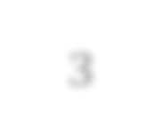
Thank You

